Slide 1



Information Communication Technology
(CSC101)
Lecture 2
Instructor: Mariam Fiaz
email: mariamsherwani434@gmail.com

Slide 2


Reference Books:
  1. Understanding Computers: Today and Tomorrow, Comprehensive – Deborah Morley & Charles S. Parker, Cengage Learning, 2017 (Read Chapters 2 & 3)

Slide 3
Contents:
  1. Storage Devices
  1.1 Magnetic Storage Devices
  1.2 Optical Storage Devices
  1.3 Solid State Storage Devices
  1.4 Data Read & Write Process
  2. How Computers Represent Data
  2.1 Number Systems
  2.2 Bits & Bytes
  2.3 Text Codes
  3. Summary of the Lecture

Slide 4
Storage Devices:
Basic Defination
A storage device is hardware used to save data, programs, and files so they can be accessed later by a computer.

Slide 5
Types of Stoarge Devices:
1. Magnetic Storage Devices
2. Optical Storage Devices
3. Solid State Storage Devices
4. Data Read & Write Process

Slide 6
1. Magnetic Storage Devices
  Definition: Devices that store data using magnetic patterns on a surface.
  Examples: Hard Disk Drives (HDD), Magnetic Tape
  Key Points:
  Data stored as binary (0s & 1s) using magnetism.
  Read/Write Head detects or changes magnetic orientation.
  Advantages: High capacity, cost-effective, long-term storage. Disadvantages: Slower than SSD, sensitive to magnets.
  Access Type: Random (HDD), Sequential (Tape).

Slide 7
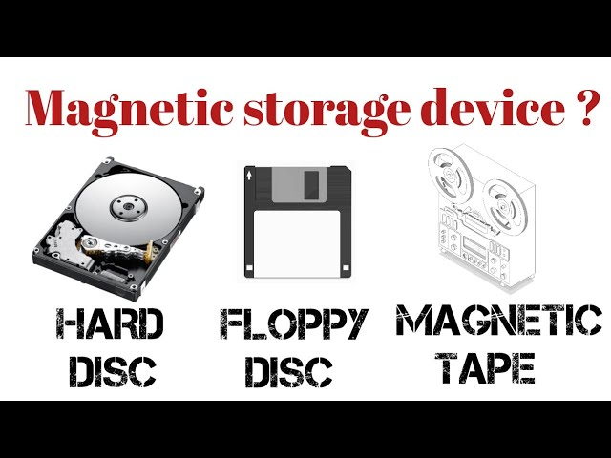

Slide 8
2. Optical Storage Devices
  Definition: Devices that use laser light to read and write data on discs.
  Examples: CD, DVD, Blu-ray
  Key Points:
  Data stored as pits and lands in spiral tracks.
  Advantages: Durable, portable, good for media storage.
  Disadvantages:Slower access speed, lower capacity than HDD/SSD.

Slide 9
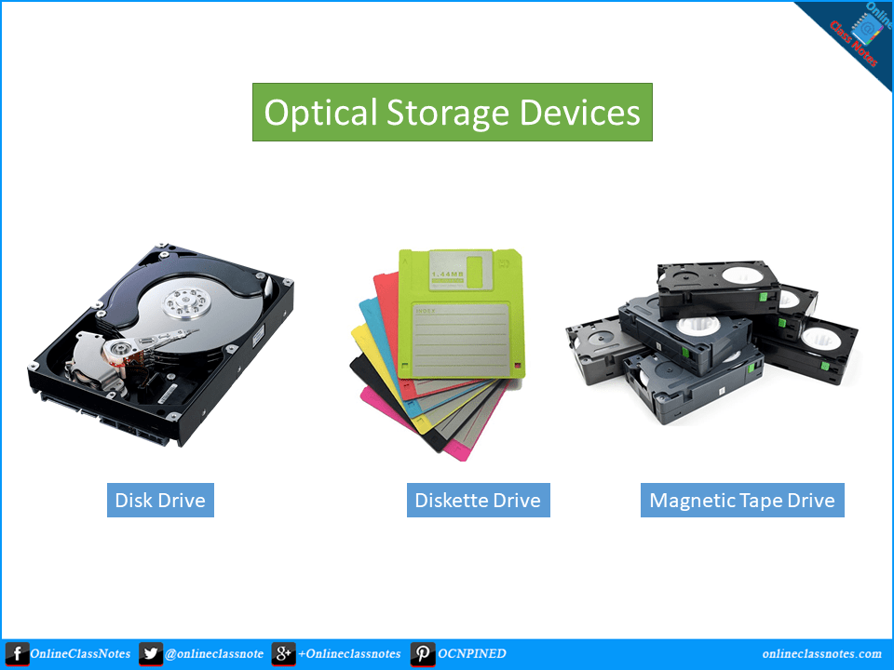

Slide 10
3. Solid State Storage Devices
  Definition: Devices that store data electronically using flash memory with no moving parts.
  Examples: SSD, USB flash drives, Memory Cards
  Advantages:
  Fast
  Durable
  Small size
  Disadvantages:
  Higher cost per GB
  limited write cycles

Slide 11
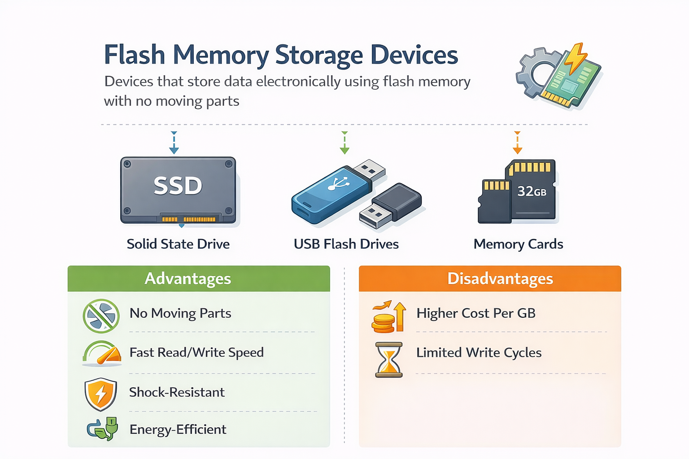

Slide 12
4. Data Read & Write Process
  Definition: The process of transferring data between storage devices and computer.
  Keys Points:
  1. Write Process:
  Computer sends binary data → storage encodes it magnetically, optically, or electronically.
  2. Read Process:
  Storage retrieves binary data → computer converts it to readable form.
  Logical (user view) vs. physical (device view) locations.

Slide 13
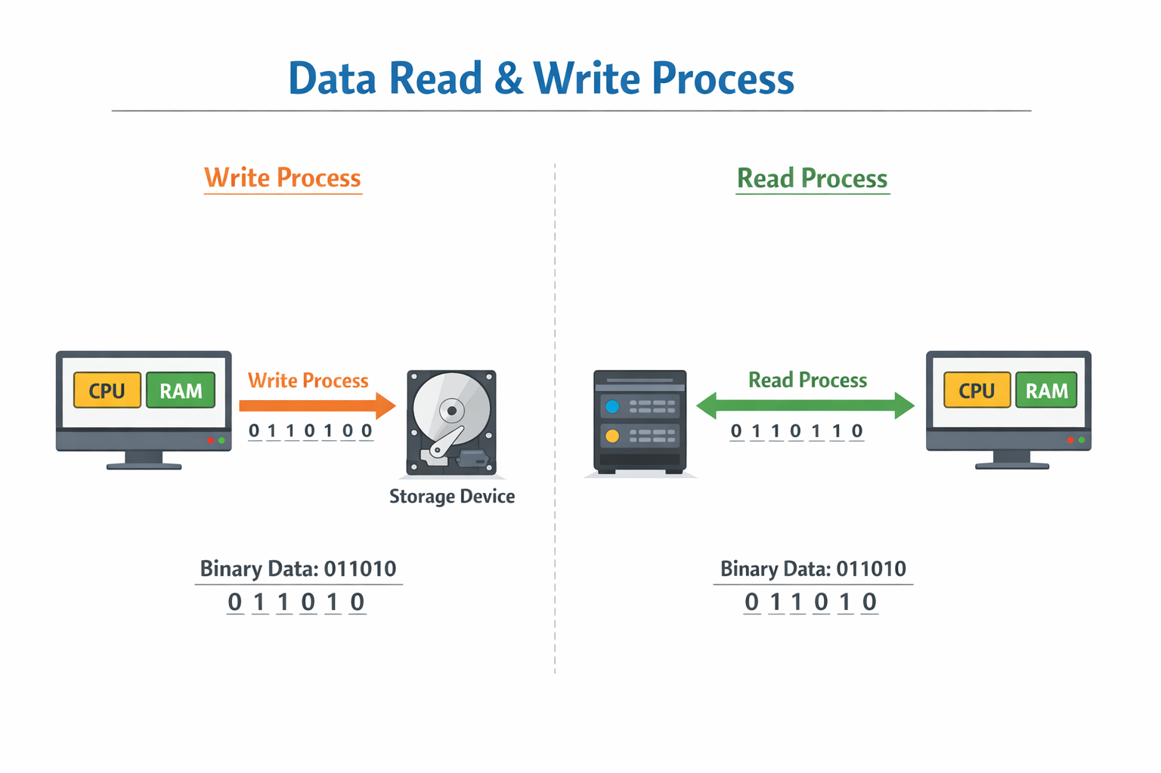

Slide 14
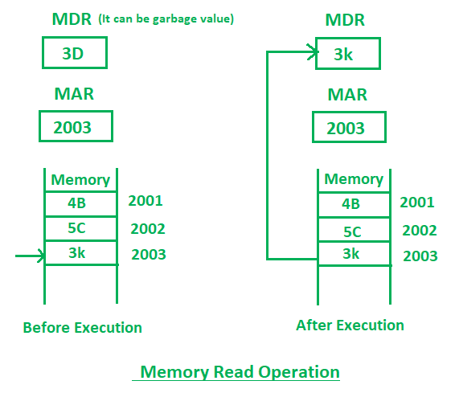
Memory Read Operation:
  Memory read operation transfers the desired word to address lines and activates the read control line. Description of memory read operation is
  given below:
In the diagram initially, MDR can contain any garbage value and MAR is containing 2003 memory address. After the execution of read instruction, the data of memory location 2003 will be read and the MDR will get updated by the value of the 2003 memory location (3D).

Slide 15
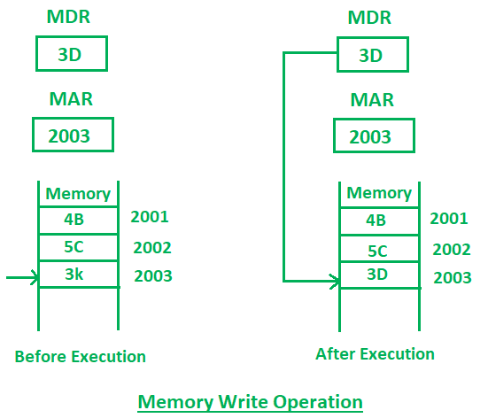
Memory Write Operation:
  Memory write operation transfers the address of the desired word to the address lines, transfers the data bits to be stored in memory to the data input lines. Then it activates the write control line. Description of the write operation is given below:
  In the diagram, the MAR contains 2003 and MDR contains 3D. After the execution of write instruction 3D will be written at 2003 memory location.

Slide 16
How Computers Process Data
Define: Data Representation
Data representation is the method by which computers convert information into binary form (0s & 1s) for processing and storage. Data can be represent by:
1. Number System
2. Bits and Bytes
3. Text Codes

Slide 17
1. Number Systems
Definition: A number system is a way of expressing numbers using a consistent set of symbols.
Types & Points:
Binary (Base-2): 0, 1 → used internally by computers.
Decimal (Base-10): 0–9 → used by humans.
Octal (Base-8): 0–7 → used as a compact representation of binary (each octal digit = 3 binary bits).
Example: Binary 101101 → group in 3 bits → 101 101 → Octal: 55
Hexadecimal (Base-16): 0–9, A–F → shorthand for binary (each hex digit = 4 binary bits).
Example: Binary 11011110 → group in 4 bits → 1101 1110 → Hex: DE

Slide 18
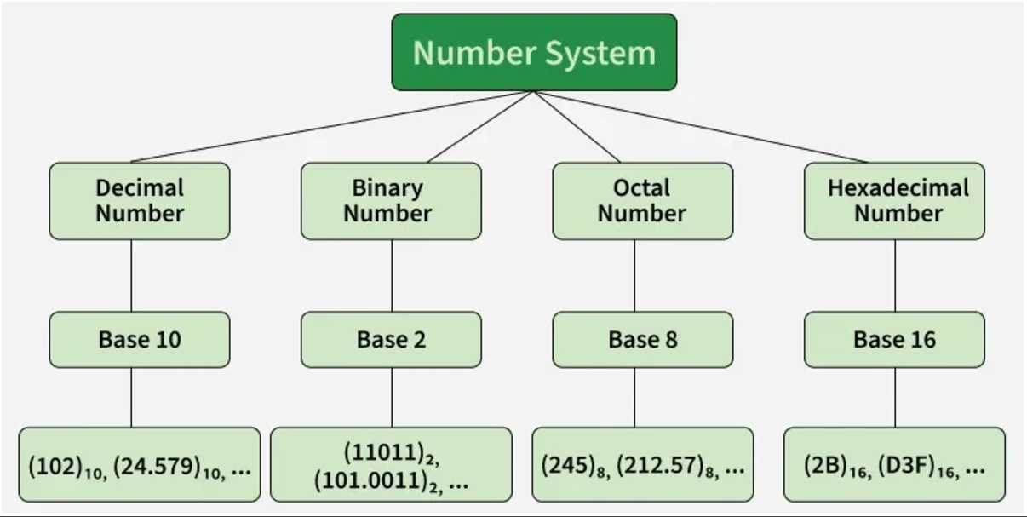

Slide 19
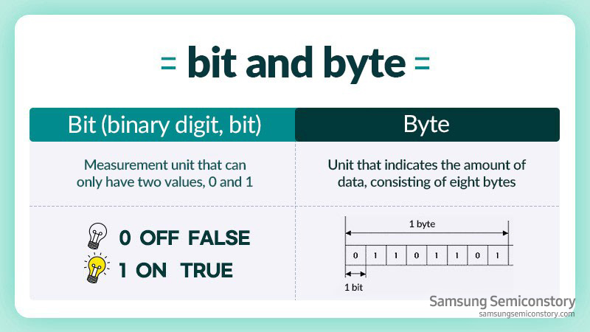
2. Bits & Bytes
  Bit Definition: Smallest unit of data in a computer, can be 0 or 1. Byte Definition: Group of 8 bits, typically represents 1 character. Points:
  Larger units: KB ≈ 1,000 bytes, MB ≈ 1,000,000 bytes, GB, TB, etc.
  Bytes measure storage and memory capacity.

Slide 20
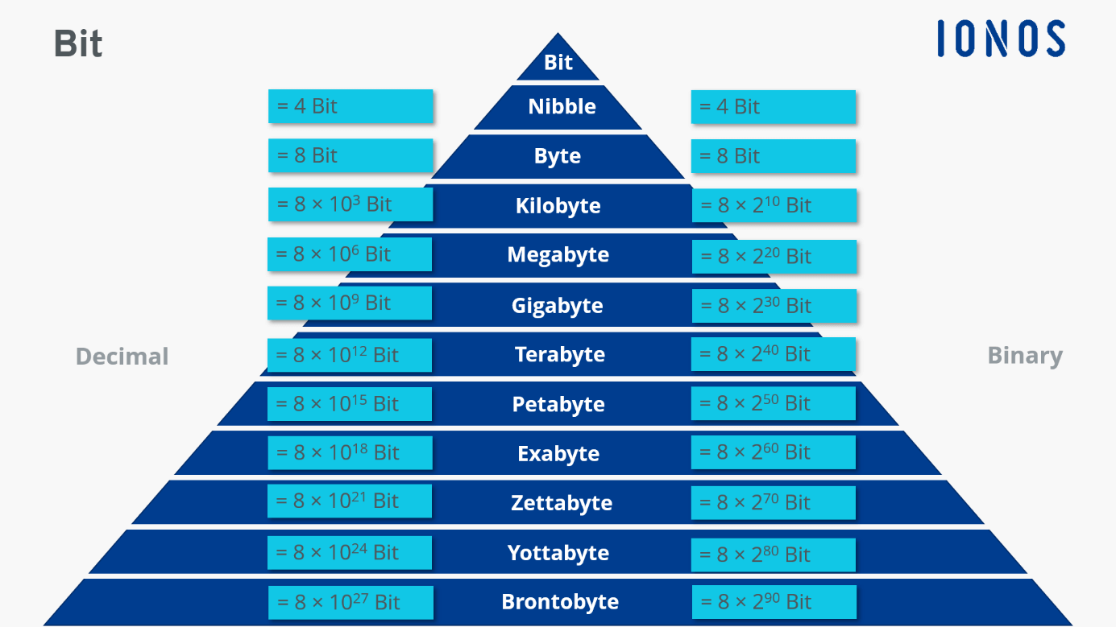

Slide 21
3. Text Codes
Definition: Codes used to convert characters into binary so computers can store and process text.
Examples & Points:
ASCII: 7/8-bit code for English characters.
Example: A → 01000001
Unicode: Supports multiple languages and symbols.
Converts letters, numbers, punctuation into unique binary sequences.

Slide 22
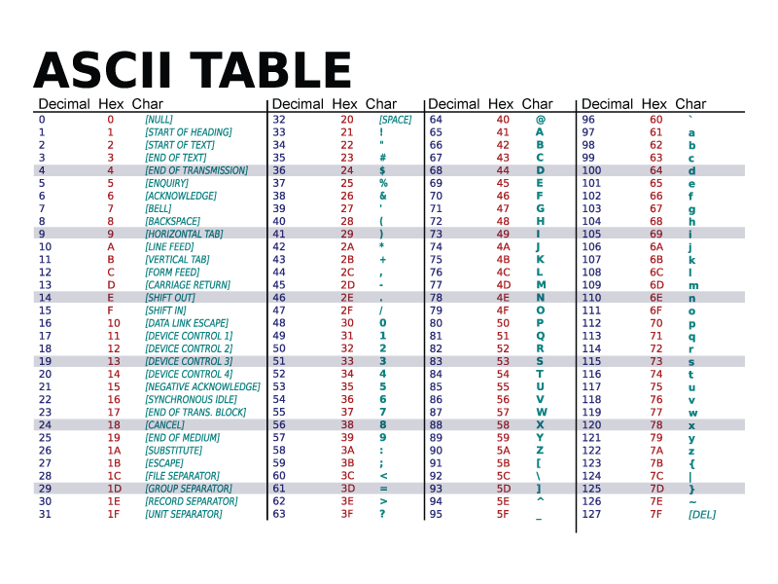
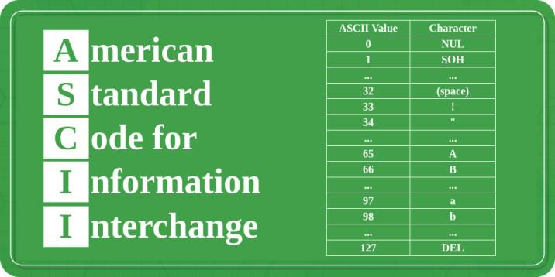

Slide 23
Summary of Lecture 2
Storage Devices: Magnetic (HDD/Tape), Optical (CD/DVD/Blu-ray), Solid State (SSD/USB).
Data Read/Write: Binary encoding, read/write heads, lasers, or flash memory.
Number Systems: Binary, Decimal, Hexadecimal – all data in binary for computers.
Bits & Bytes: Bit = 0/1, Byte = 8 bits, units of measurement.
Text Codes: ASCII & Unicode convert human-readable text to computer-readable binary.

